Slide 1
We need help!
Website
Electricity Grid
Brewery
Automatic LP checking
Cross-state compacts
Biofuels
Environmental flows
Investment under political parties and local feedback

Slide 2
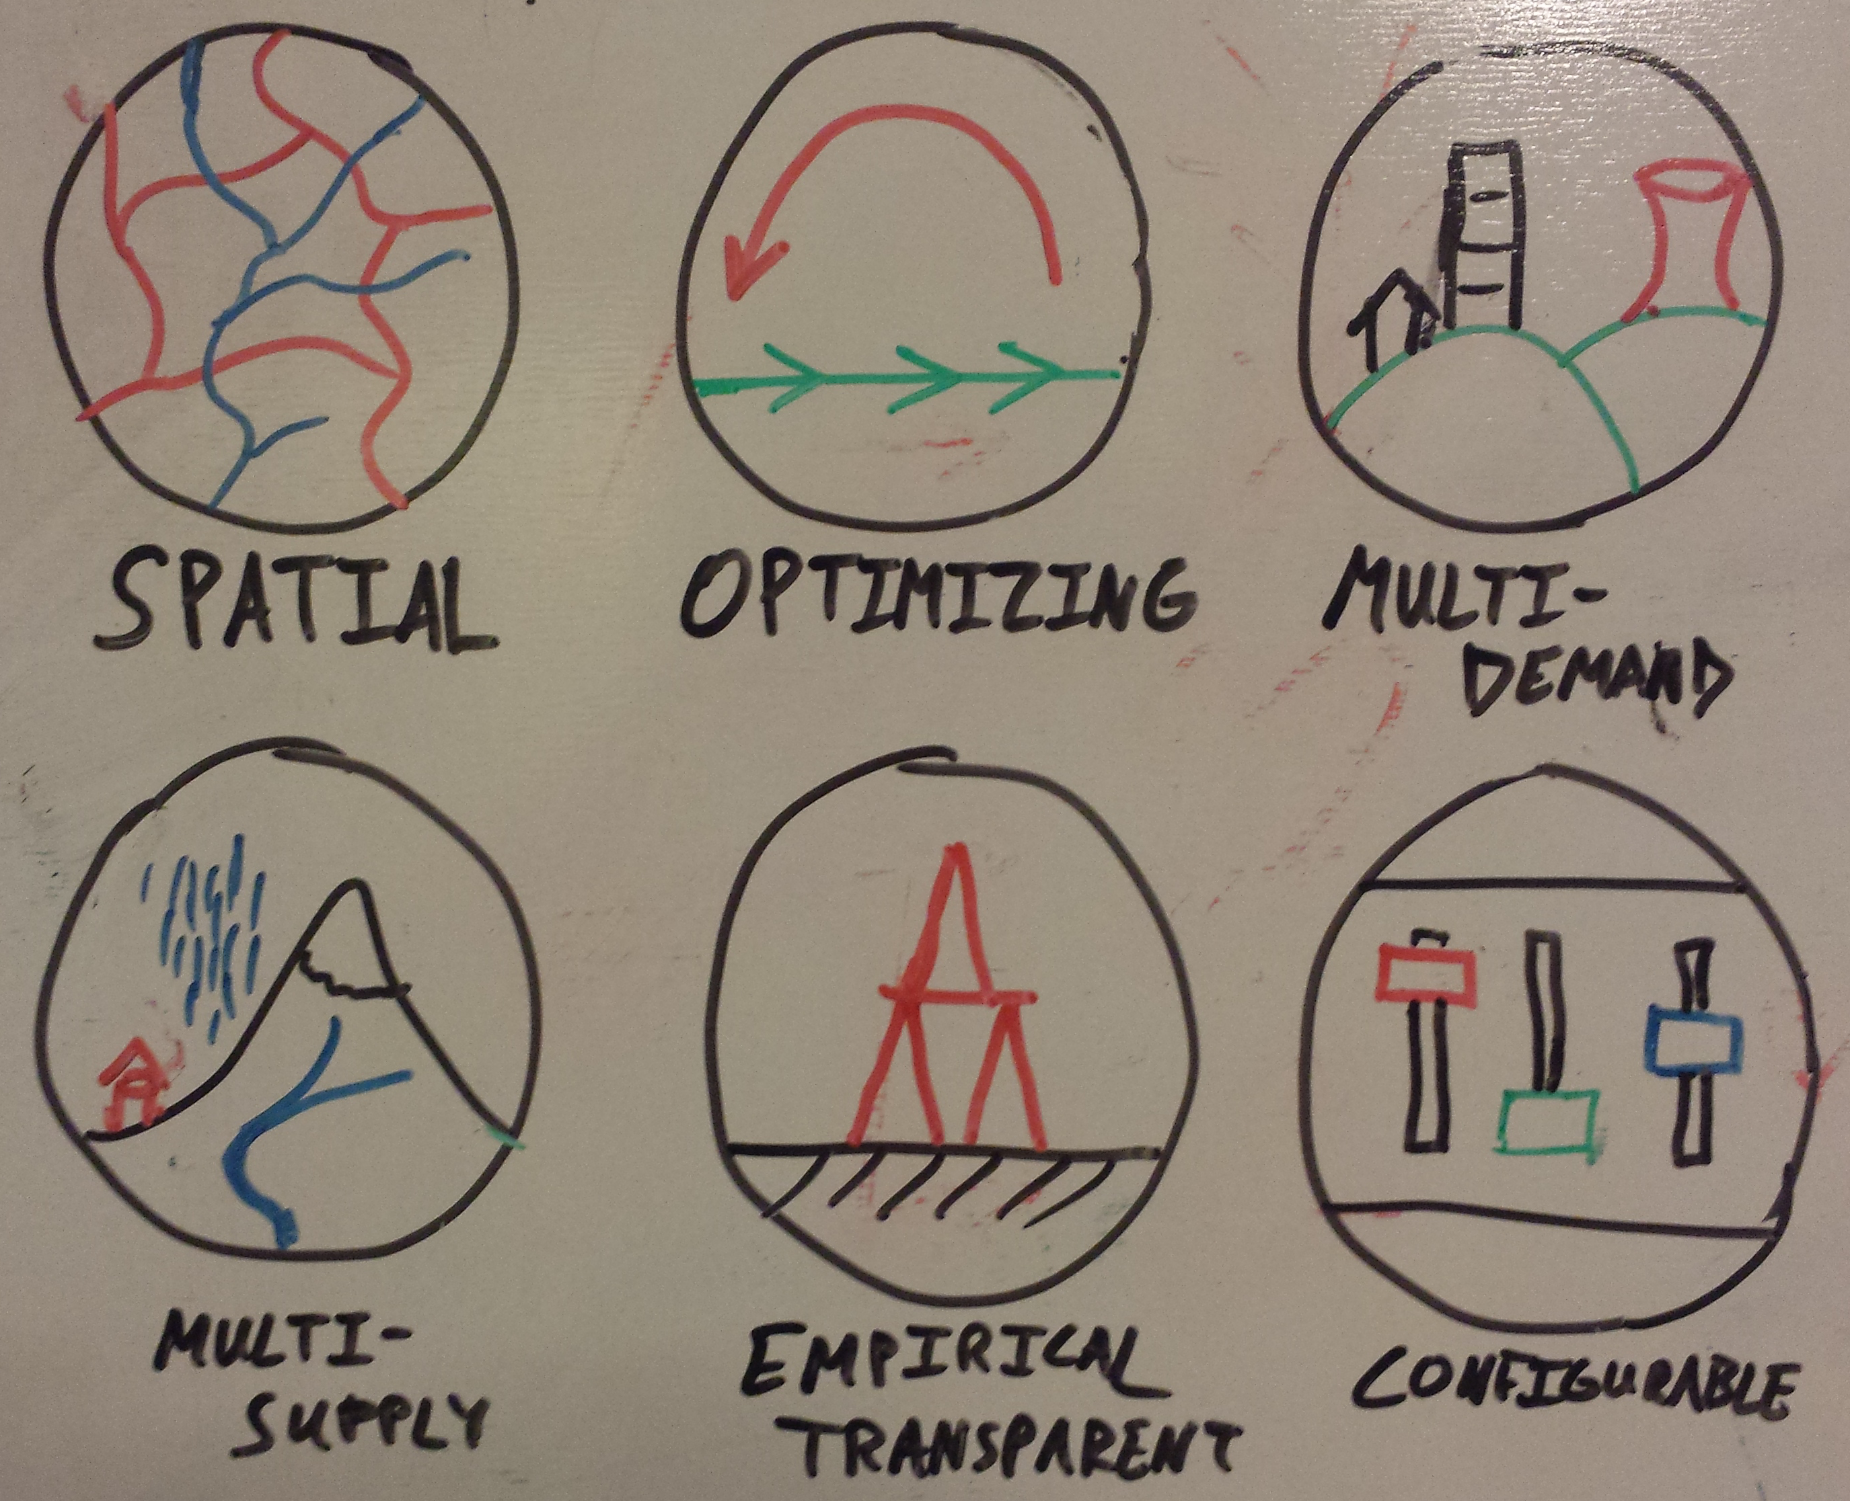
A Website

Slide 3
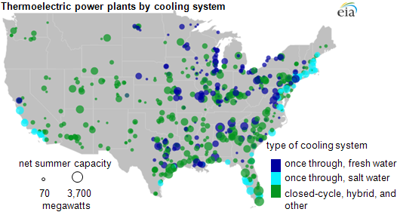
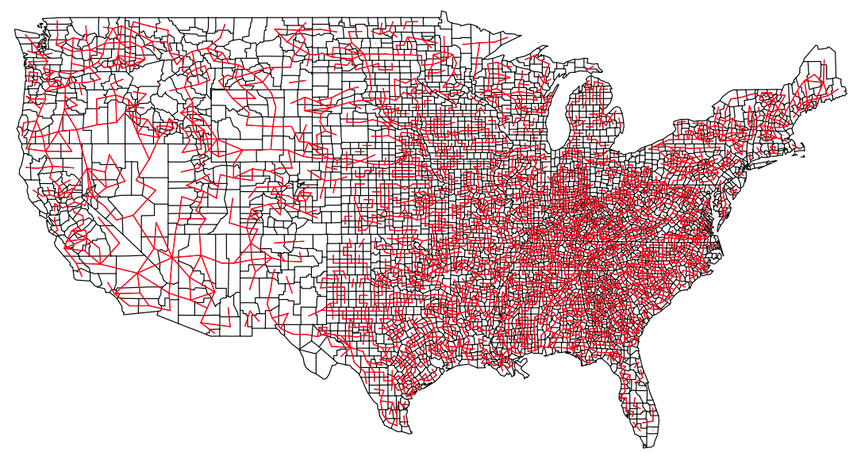
Electricity Grid

Slide 4
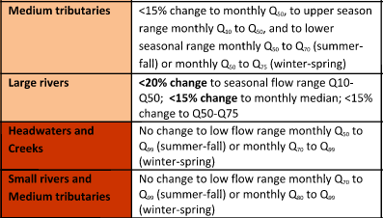
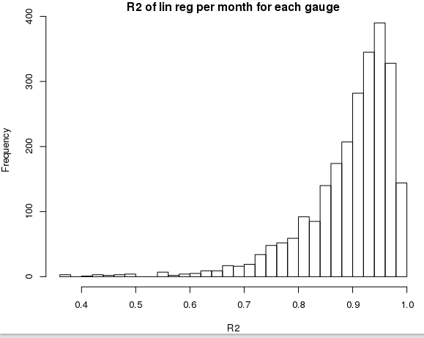
Implementing environmental flows
Unmodified monthly flows from VIC
Recommendations follow flow-duration curve
Monthly to daily quantiles linear

Slide 5
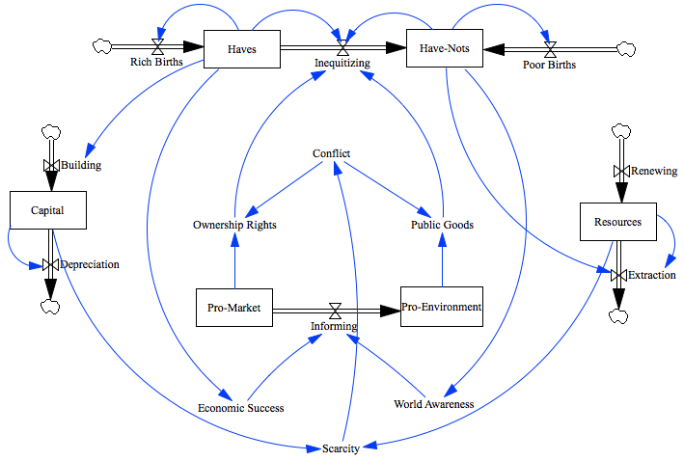
Political modeling

